Slide 1
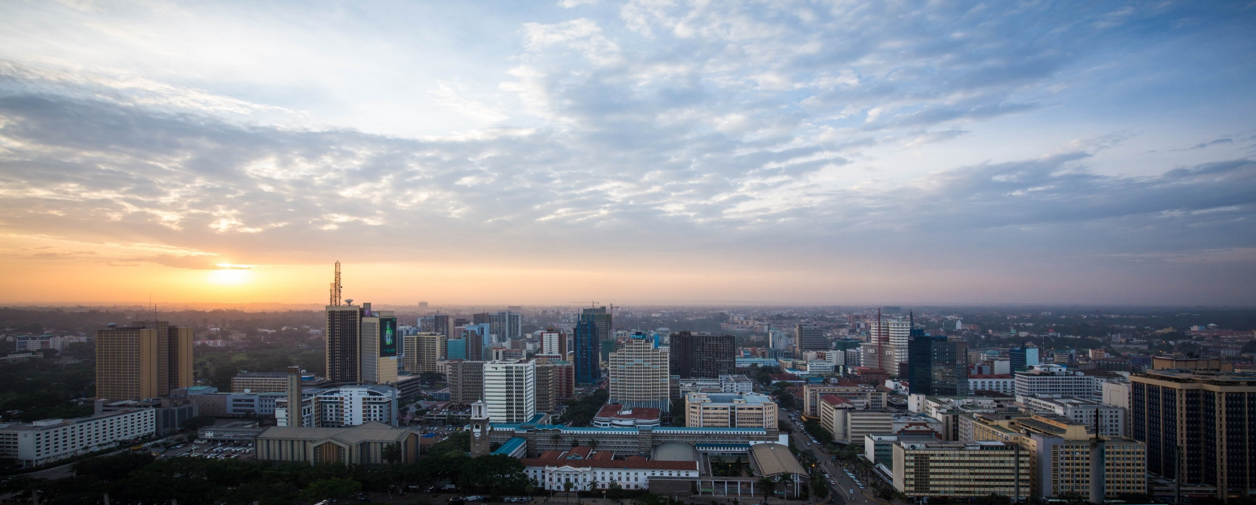
EXPORT PROCESSING ZONES AUTHORITY
Presentation at a Collaborative Learning and Adapting Event on Breaking Trade Barriers for Women and Youth Entrepreneurs – US AGOA Opportunity Session
8th June 2023
Movenpick Hotel, Westlands, Nairobi

Slide 2
PRESENTATION OUTLINE
The Export Processing Zones (EPZ) Program
EPZA Mandate.
Performance And Status
Export Processing Zones Authority
your investment & trade partner

Slide 3
INTRODUCTION TO THE EPZ PROGRAM
The Export Processing Zones (EPZ) Program is an incentivized program for export oriented trade created to promote export oriented industrial investment within designated zones.
It was enacted in 1990 through the Export Processing Zones Act (CAP 517 of the Laws of Kenya)
The Export Processing Zones Authority (EPZA) a state corporation under the Ministry of Investments, Trade and Industry was set up to manage the EPZ program.
Export Processing Zones Authority
your investment & trade partner

Slide 4
EPZA MANDATE
EPZA’s mandate is the development of all aspects of Export Processing Zones particularly;
Provision of advice on the removal of impediments to, and creation of incentives for export oriented production
Regulation and administration of approved activities within the export processing zones
Protection of government revenues and foreign currency earnings
Export Processing Zones Authority
your investment & trade partner

Slide 5
OBJECTIVES OF THE EPZ PROGRAM
The EPZ program is a key economic development program for the Government of Kenya and is designed with various goals:
Generation of employment opportunities
Promotion and diversification of exports
Attracting new productive investments
Development of backward linkages
Skills and technology transfer
Export Processing Zones Authority
your investment & trade partner

Slide 6
EPZ INCENTIVES
Fiscal Incentives
10-year Corporate Tax Holiday
10-year Withholding Tax Holiday
100% Investment Deduction allowance
Exemption from
Import Duty
Value Added Tax
Stamp Duty
Procedural Incentives
Single License
Fast-track of applications & approvals
Green Channel Port Clearance and Customs facilitation
Government Inter-agency liaison services
Quality Infrastructure Incentives
Availability of land and factory buildings
Fresh water supply and superior water reticulation system
Superior sewer reticulation system and world-class Effluent Treatment Plant.
Designated Electric power station.
Export Processing Zones Authority
your investment & trade partner

Slide 7
EPZ LICENSES
Developer / Operator License
Construction and leasing out warehouses
Enterprise License
Manufacturing or Service activities
Commercial License
Breaking bulk, repackaging, re-labelling and trading
Business Service Permits (BSPs) - permit to serve the EPZ community and environs
Export Processing Zones Authority
your investment & trade partner

Slide 8
PERFORMANCE AND STATUS OF THE EPZ PROGRAM
Ksh. 134 bn worth of investment
Ksh. 23.4 bn spent on local purchases
Over 83,000 people directly employed
89 gazetted zones and 156 enterprises across Kenya
Ksh. 106 bn in exports, 54 bn to USA (AGOA) and Ksh. 63.6 bn in imports
Skills & Technology transfer
Development of backward & forward linkages
Attractive new investments
Growth of towns e.g Kitengela, Mazeras
Ksh. 18.2 bn spent on salaries
Ksh. 48.4 bn spent on total domestic expenditure
Export Processing Zones Authority
your investment & trade partner

Slide 9
SAMPLE OF THE EPZ COMPANIES
Revital Health EPZ (Kilifi)
Pharmaceuticals and Medical supplies
First African Country licensed to produce Covid-19 syringes – 1 out of 6 in the world
MAS Intimates EPZ (Athi River)
Largest Garment factory in Sri Lanka
Set up in 2019 and goal is to employ 5,000 by 2023
De La Rue (Nairobi)
Currency & Security Print
Exporting currency
Emrok Tea EPZ (Nandi)
Tea Exporters
Awarded best specialty tea
3,000+ small scale farmers
African Coffee Roasters EPZ (Athi River)
Only organic coffee exporters in the Kenya
Amor Coco EPZ (Kilifi)
Coconut oil
Reviving the Coconut Industry at the coast.
Privamnuts (Embu)
Macademia nut exporters
Connected to over 80,000 farmers
Begun in 2016
Export Processing Zones Authority
your investment & trade partner

Slide 10
THANK YOU
For more information, contact us;
+254 45 662 1000 , +254 733 683 222
info@epzakenya.com
www.epzakenya.com
Your Investment and Trade Partner
Export Processing Zones Authority
your investment & trade partner

