Slide 1
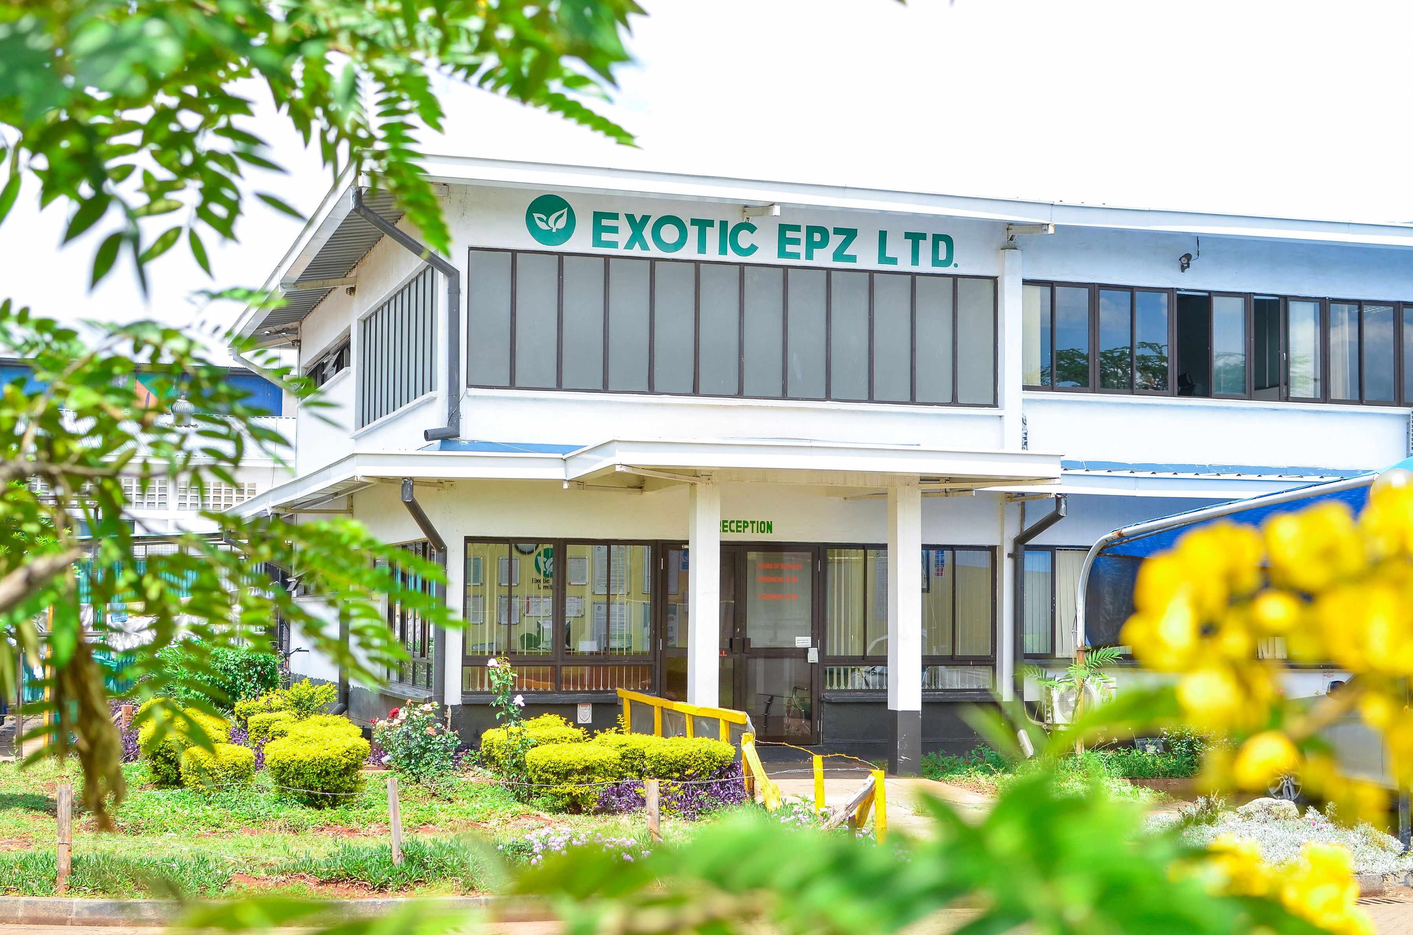

Slide 2
Women led enterprise
Provide access to global markets
Strong Social and Environmental Impact Focus
High Growth Ambitions
2

Slide 3
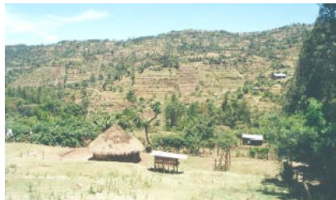
+need for stable market for produce from over 200,000 SHFs in macadamia VC
Land Degradation – climate change impacts
High unemployment esp among youth

Slide 4
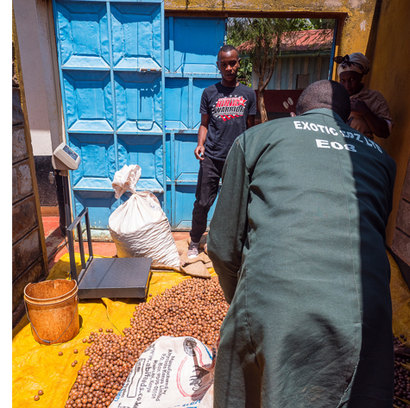
We provide consistent market for farmers produce, pay promptly via Mpesa and support smallholders with GAP skills

Slide 5
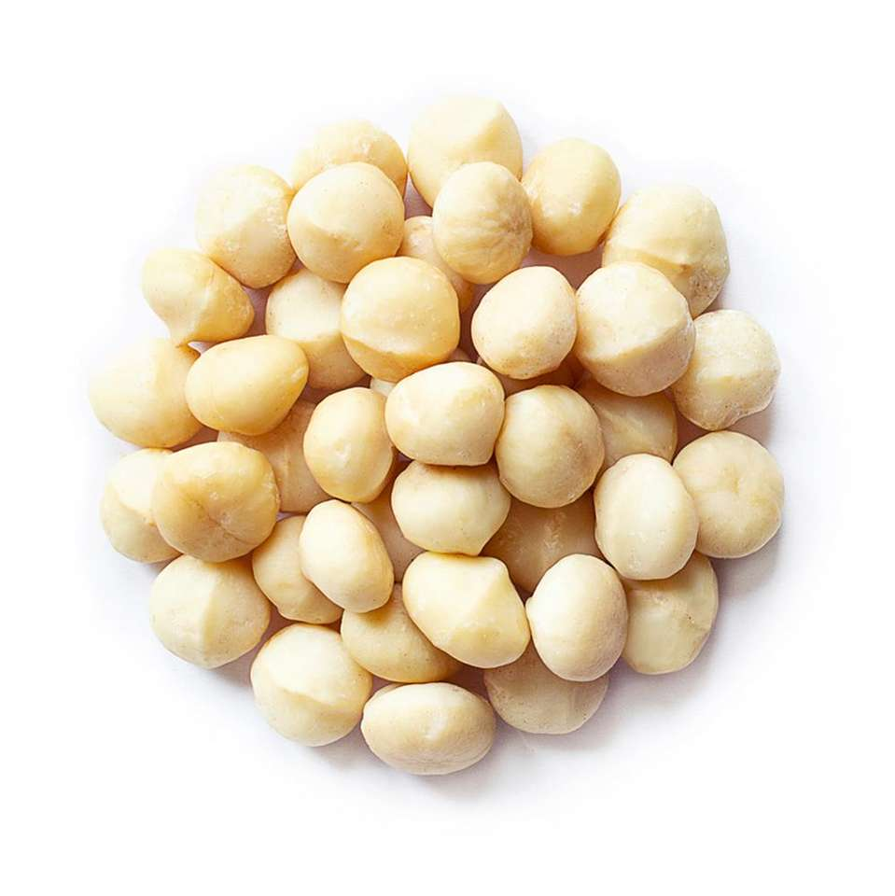
We Process and Export a high quality product consistently to international customers in USA, Europe and Asia

Slide 6
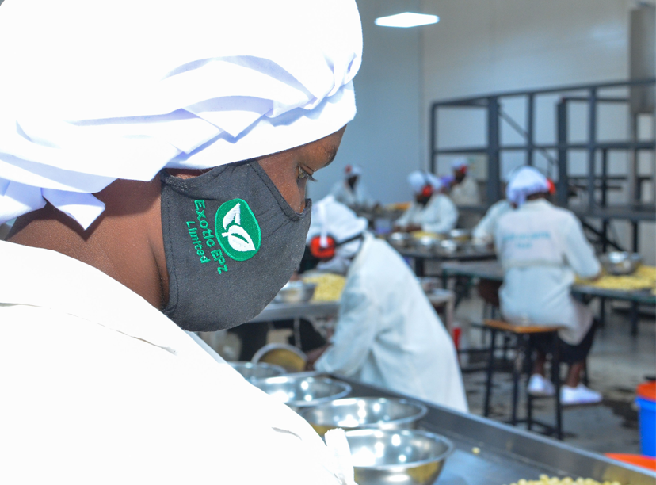
We are creating decent jobs for over 187 workers

Slide 7
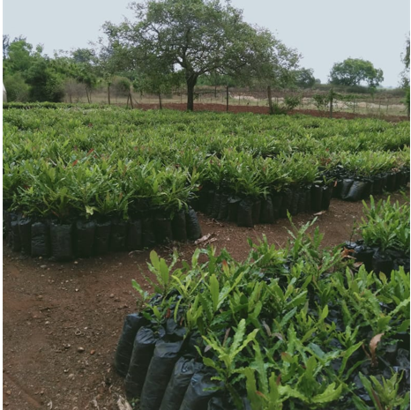
Supporting land restoration through agro-forestry – plantations of macadamia trees

Slide 8
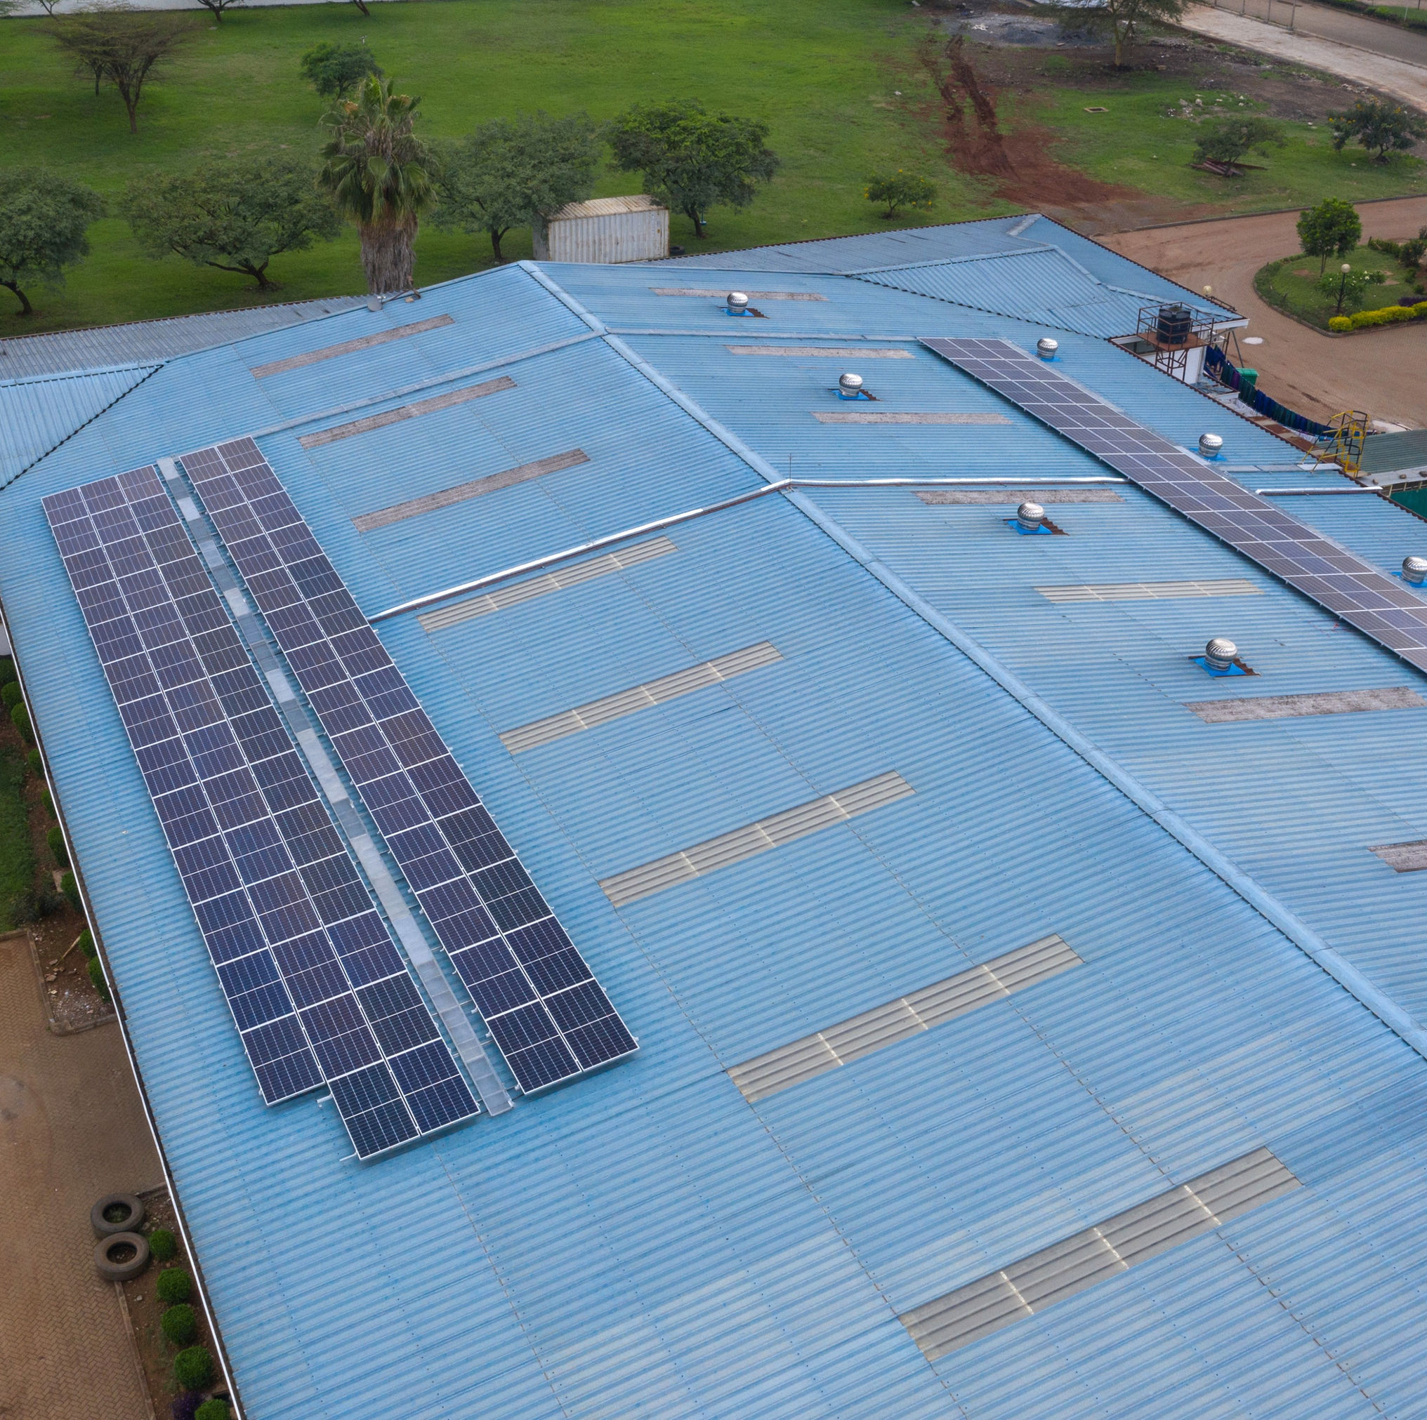
Use of renewable and energy efficient technologies at our factory

Slide 9
BUSINESS MODEL
FARMERS HARVEST
NUTS
FARMERS BRING NUTS TO COLLECTION CENTRES
OUR FIELD TEAMS INSPECT AND SELECT HIGH QUALITY NUTS
NUTS DRIED AND PROCESSED IN THE FACTORY
PACKAGING AND WAREHOUSING
TRANSPORT TO PORT
SHIPMENT TO BUYER
8
8

Slide 10
IMPACT IS AT THE HEART OF OUR MISSION
ENVIRONMENTAL IMPACT
GENDER INCLUSIVITY AND EMPOWERMENT PROGRAMMES
IMPROVING FARMER
LIVELIHOODS
JOB CREATION
Income
Empowerment
Environment
14
14

Slide 11
Exotic EPZ Limited
Sameer Industrial Park (unit 8) Enterprise/Mombasa Rd junction P.O. BOX 13779 - 00100
Nairobi, KENYA
Tel: +254 (0) 728545108
Website: www.exoticepz.co.ke E-mail: jane@exoticepz.co.ke

