Slide 1
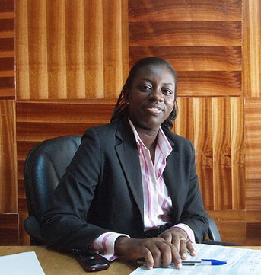
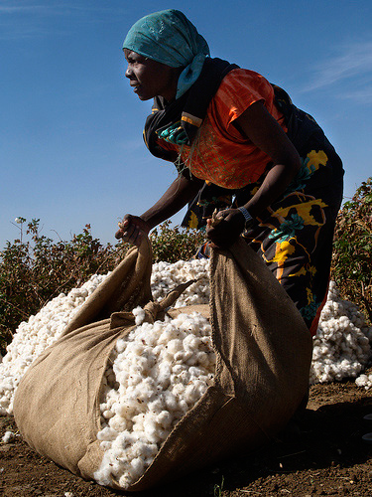
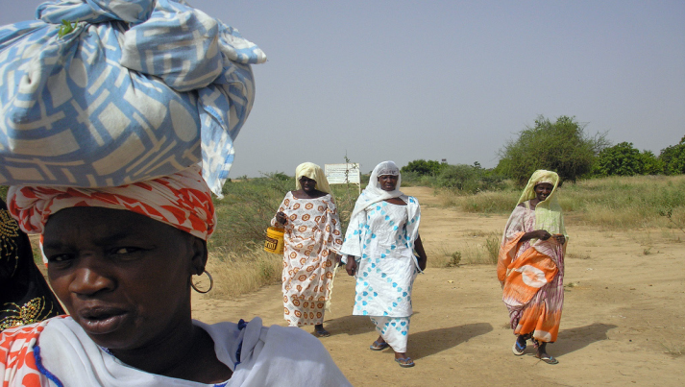
Women and Trade in Africa: Realizing the Potential
Paul Brenton
Trade Practice Leader
Africa Region
World Bank

Slide 2
Great Potential for Intra-Africa Trade

Slide 3
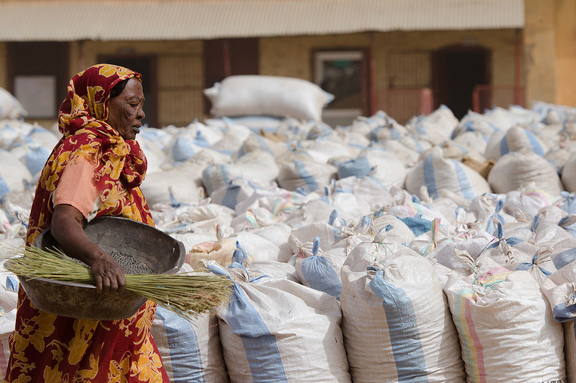
Women heavily involved in trade in Africa……
Cross-border traders
Producers of traded goods and services
Entrepreneurs who manage export firms
key to Africa realising its trade potential

Slide 4
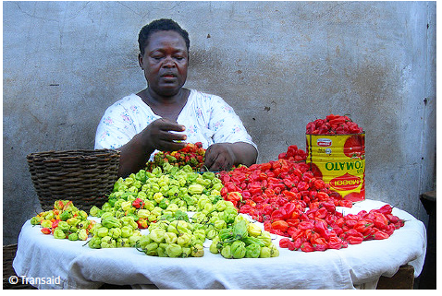
…but contribution often overlooked by policy makers
Lack of data and awareness
Lack of analysis
Lack of representation in trade policy discussions

Slide 5
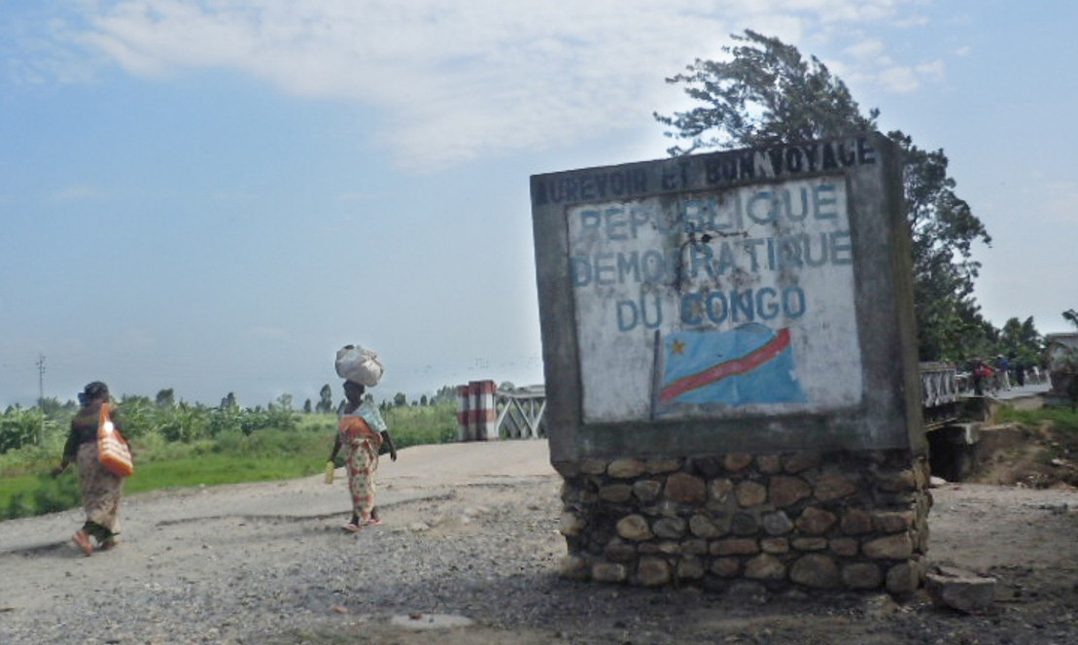
Women face specific trade barriers
Lack of transparency and awareness of rules
Difficulties in obtaining required documents
Access to trade information and trader networks
Poor conditions and harassment when crossing border

Slide 6
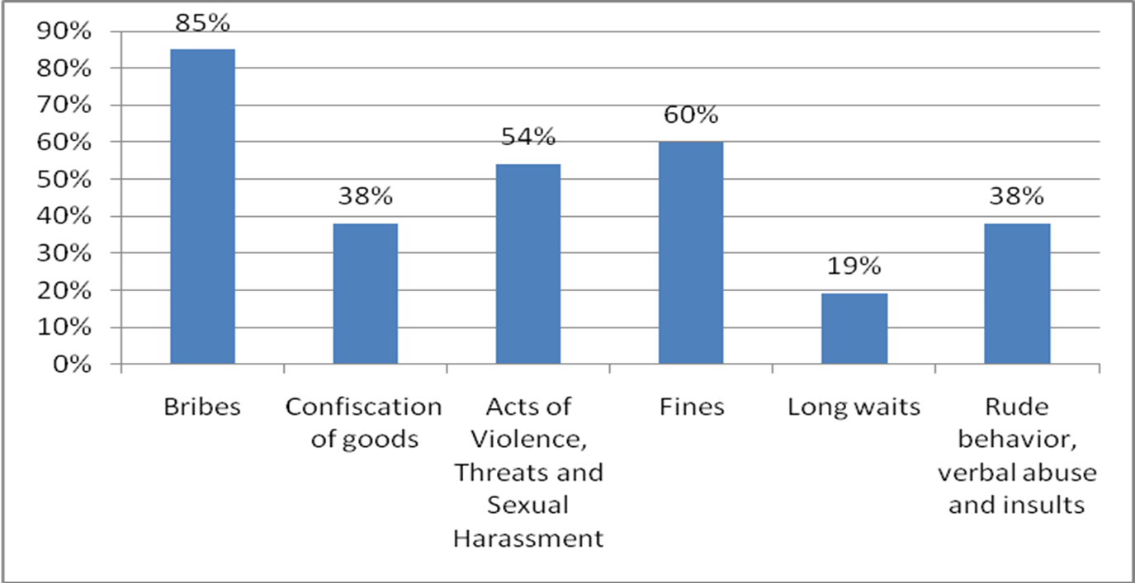
Women often face substantial risks when crossing borders
A Charter for cross-border traders
Supported by measures to change behaviour

Slide 7
Charter for Cross-Border Trade (1)
Traders processed efficiently, without discrimination or harassment;
Physical checks of traders must be recorded with the reason and outcome provided.
All duties, fees and taxes and methodology are publicly available at the border;
Documentary requirements should be clearly stated and publicly available at the border;
Basic rights and obligations for traders and officials
© Susan Novak

Slide 8
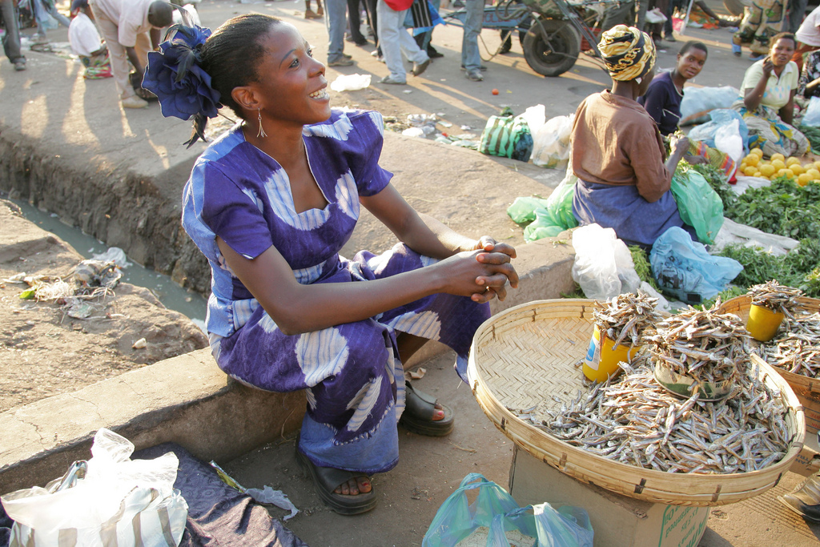
Charter for Cross-Border Trade (2)
Visible communication of basic rights and obligations at all border crossings;
All senior officials and 50% of officials received gender awareness training;
At all border posts traders can register violation of basic rights;
Apply strict disciplinary measures against abusive officials;
With the support of the international community, governments commit to:
©Stevie Mann/World Fish

Slide 9
Constraints on producers of exports
Exports limited by relative lack of access to key inputs for women
Women excluded from trader networks
Services trade offers new opportunities for women
ownership more likely for services firms
But in some sectors (tourism) limited to low-wage jobs
In professional services conditions enabling participation as favourable in Africa as elsewhere

Slide 10
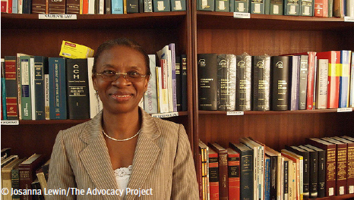
Export entrepreneurs
Female run firms just as likely to export
But women-owned firms concentrated in low export intensive sectors
Women-owned firms smaller and operate across more sectors – a strategy of risk aversion
Female-led exporters more likely to export regionally than globally
Key role for regional integration

Slide 11
Simple steps to facilitate trade
Recognise role that women play in trade
Clear and transparent regulations governing trade
Simplify trade requirements
Effective design of interventions to facilitate trade
Assist women to address risks they face in trading
Marcelo M. Giugale, Director, Economic Policy, World Bank Africa Region, “The potential benefits are huge and obvious: better food security, faster job creation, more poverty reduction, and less gender discrimination. This is a win-win-win-win reform agenda that is ready for action.”

Slide 13
Now also showing on Vimeo

Slide 14
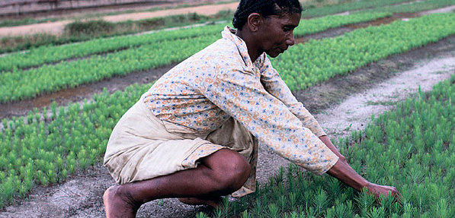
Thank you
www.worldbank.org/afr/trade

Slide 15
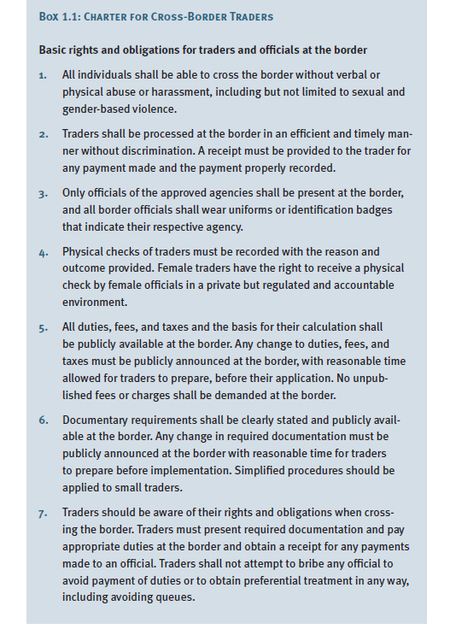

Slide 16
